Slide 1
Flagging-drop typology and contact-induced change
Hiwa Asadpour
JSPS International Fellow, University of Tokyo, Japan
Associate Researcher, Goethe University of Frankfurt, Germany
Asadpour@lingua.uni-frankfurt.de
DGfS2023, Cologne University
07-10 March 2023
Notes:
Thank you so much everyone for being present at my talk today. In this presentation, my objective is to give a survey with respect to the explanation for different kinds of flagging related to a special type of elements called Target in my study. By flagging I refer to marking an element with an adposition or case marking. This feature is one of morphosyntactic features which I investigated in analyzing factors relevant to the study of word order variation. In the study of word order [go to the next slide]

Slide 2
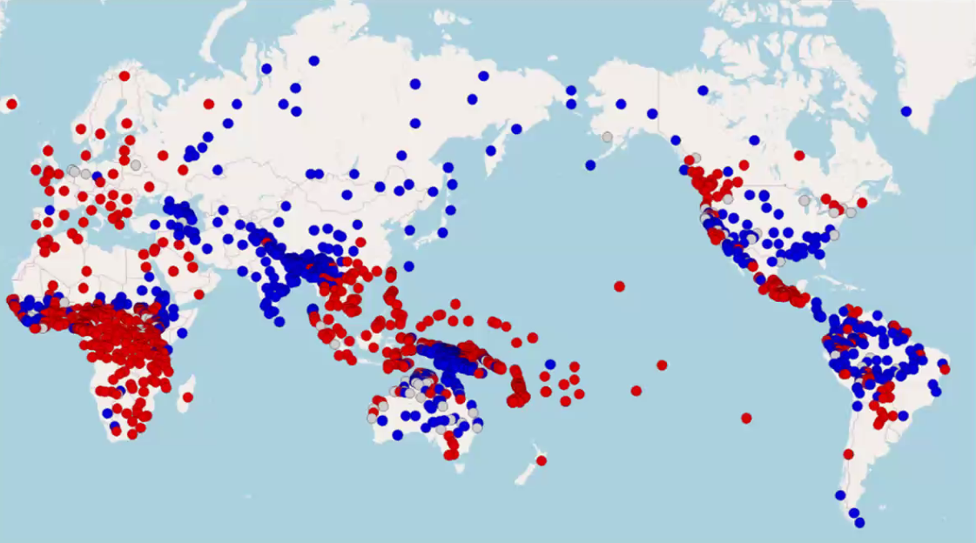
Dryer (2013), WALS
Left-branching (OV)
(e.g., Turkic)
Right-branching (VO)
(e.g., Semitic)
Notes:
generally, languages are classified into object-verb and verb-object word ordering. Based on the typological classifications of Greenberg, Dryer and Hawkins gave an overview of different word order typologies, such as left-branching languages in blue, for example, Turkic, and right-branching languages in red, for example Semitic. Regarding the parameters of OV vs. VO serialization and flagging, Greenberg offers the following types: [go to the next slide]

Slide 3
Dryer (2013), WALS
Type 1: VSO, PREP
Type 9: SVO, PREP
Type 23; SOV, POST
Notes:
Greenberg, further, stipulated Universal 4:

Slide 4
Dryer (2013), WALS
“With overwhelmingly greater than chance frequency, languages with normal SOV order are postpositional.”
Notes:
Based on Greenberg’s classification and Universal 4, we expect to have the following types:

Slide 5
Dryer (2013), WALS
Left-branching (OV)
Right-branching (VO)
postpositional + Genitive-Noun
prepositional + Noun-Genitive
Dryer (2013)
Notes:
However, in a region shared between Iran, Turkey, Armenia, Azerbaijan, and Iraq, the languages, show mixed asymmetries. In contrast to this typological classification,

Slide 6
Dryer (2013)
Left-branching (OV)
Right-branching (VO)
postpositional + Genitive-Noun
prepositional + Noun-Genitive
Notes:
in the northwest Iran, the sample languages show typologically unusual word order combinations such as [go to the next slide]

Slide 7
Dryer (2013)
Left-branching (OV)
Right-branching (VO)
postpositional + Genitive-Noun
prepositional + Noun-Genitive
OV + prepositional + NG / VO + postpositional + GN
Notes:
Left-branching languages with prepositional plus noun before genitive attribute. Such patterns are considered to be unusual because the idea is that right-branching and left-branching come into conflict, so typologists claim languages are either right-branching or left-branching and if they have the features of both then it is thought to be unusual. Therefore, Haig (2015 and his subsequent works) suggest that in Goal structures [go to the next slide]

Slide 8
Dryer (2013)
Left-branching (OV)
Right-branching (VO)
postpositional + Genitive-Noun
prepositional + Noun-Genitive
OV + prepositional + NG / VO + postpositional + GN
Contact situations
Notes:
Such patterns only arise in contact situations. Following Harris and Campbell’s contact statement, Haig (2015) claims that the postverbal Goal elements in Iranian languages especially Kurdish are the result of contact-indcued change with Semitic languages. Before further elaboratin on the topic flagging types and ist development, in the next slide, I will first introduce the terminology and sample languages [go to the next slide]

Slide 9
Terminology
Geography and sample languages
Notes:
I will first provide you with information on the main terminology in the study which is ‘Target’, the region of the study and sample languages [go to the next slide]

Slide 10
Target event structure and
Target (T)?
Notes:
My term of 'Target’ which is developed in 2015 originates in Haig’s (2014 and 2015) discussion of 'Goals’ under which he subsumes local goals of movement and caused motion verbs, recipients, and addressees encoded by “full NPs”. Eventually he encompassed final-states as well in his latest work. [go to next slide]

Slide 11
My father goes to school.
Physical Goals
of verbs of movement (MOTION)
John put the book on the table.
Physical Goals
of verbs of caused motion (CAUSED-MOTION)
He looked at the building.
Metaphorical Goals
of verbs of LOOK
He showed the book to his father.
Metaphorical Goals
of verbs of SHOW
He became [to] a professor.
Resultant-states
of verbs of change-of-state (CHANGE-of-STATE)
My father gave the book to his son.
Recipients
of verbs of transferred possession (GIVE)
Beneficiaries
of verbs of transferred possession (BENEFICIARY)
He said to me the story of the king.
Addressees
of verbs of speech (SAY)
Notes:
In my research, I observed that physical goals of MOTION and CAUSED-MOTION verbs,

Slide 12
My father goes to school.
Physical Goals
of verbs of movement (MOTION)
John put the book on the table.
Physical Goals
of verbs of caused motion (CAUSED-MOTION)
He looked at the building.
Metaphorical Goals
of verbs of LOOK
He showed the book to his father.
Metaphorical Goals
of verbs of SHOW
Resultant-states
of verbs of change-of-state (CHANGE-of-STATE)
My father gave the book to his son.
Recipients
of verbs of transferred possession (GIVE)
Beneficiaries
of verbs of transferred possession (BENEFICIARY)
He said to me the story of the king.
Addressees
of verbs of speech (SAY)
Notes:
Metaphorical goals of LOOK and SHOW verbs,

Slide 13
My father goes to school.
Physical Goals
of verbs of movement (MOTION)
John put the book on the table.
Physical Goals
of verbs of caused motion (CAUSED-MOTION)
He looked at the building.
Metaphorical Goals
of verbs of LOOK
He showed the book to his father.
Metaphorical Goals
of verbs of SHOW
He became [to] a professor.
Resultant-states
of verbs of change-of-state (CHANGE-of-STATE)
My father gave the book to his son.
Recipients
of verbs of transferred possession (GIVE)
Beneficiaries
of verbs of transferred possession (BENEFICIARY)
He said to me the story of the king.
Addressees
of verbs of speech (SAY)
Notes:
Resultant-state of Change of State verbs, and similarly,

Slide 14
My father goes to school.
Physical Goals
of verbs of movement (MOTION)
John put the book on the table.
Physical Goals
of verbs of caused motion (CAUSED-MOTION)
He looked at the building.
Metaphorical Goals
of verbs of LOOK
He showed the book to his father.
Metaphorical Goals
of verbs of SHOW
He became [to] a professor.
Resultant-states
of verbs of change-of-state (CHANGE-of-STATE)
My father gave the book to his son.
Recipients
of verbs of transferred possession (GIVE)
Beneficiaries
of verbs of transferred possession (BENEFICIARY)
Addressees
of verbs of speech (SAY)
Notes:
Recipients of GIVE verbs, and

Slide 15
My father goes to school.
Physical Goals
of verbs of movement (MOTION)
John put the book on the table.
Physical Goals
of verbs of caused motion (CAUSED-MOTION)
He looked at the building.
Metaphorical Goals
of verbs of LOOK
He showed the book to his father.
Metaphorical Goals
of verbs of SHOW
He became [to] a professor.
Resultant-states
of verbs of change-of-state (CHANGE-of-STATE)
My father gave the book to his son.
Recipients
of verbs of transferred possession (GIVE)
Beneficiaries
of verbs of transferred possession (BENEFICIARY)
He said to me the story of the king.
Addressees
of verbs of speech (SAY)
Notes:
Addressees of SAY verbs, often appear in the special postverbal position. The peculiarity made me to create a set category as a working term which is called ‚"Target". In addition [go to the next slide]

Slide 16
[+/-flagging]
My father goes to school.
Physical Goals
of verbs of movement (MOTION)
John put the book on the table.
Physical Goals
of verbs of caused motion (CAUSED-MOTION)
He looked at the building.
Metaphorical Goals
of verbs of LOOK
He showed the book to his father.
Metaphorical Goals
of verbs of SHOW
He became [to] a professor.
Resultant-states
of verbs of change-of-state (CHANGE-of-STATE)
My father gave the book to his son.
Recipients
of verbs of transferred possession (GIVE)
Beneficiaries
of verbs of transferred possession (BENEFICIARY)
He said to me the story of the king.
Addressees
of verbs of speech (SAY)
He sings a song for John.
Beneficiaries
of verbs of transferred possession (BENEFICIARY)
Notes:
BENEFICIARIES, which usually have the same morphological marking are also included in the set category. I have considered Goals, Recipients, Addresses, resultant states, and BENEFICIARIES as one group for semantic reasons and because that they all share the same morphology. Typologically, the morphological marking is expected, but the peculiar point is that they can also be without any marking which I called ‘bare’ in my study. The reason why I have been motivated to set up this semantic-syntatic category is because [go to the next slide]

Slide 17
SOURCE (cause ) MOVE (OBJECT) TARGET
[+/-flagging]
My father goes to school.
Physical Goals
of verbs of movement (MOTION)
John put the book on the table.
Physical Goals
of verbs of caused motion (CAUSED-MOTION)
He looked at the building.
Metaphorical Goals
of verbs of LOOK
He showed the book to his father.
Metaphorical Goals
of verbs of SHOW
He became [to] a professor.
Resultant-states
of verbs of change-of-state (CHANGE-of-STATE)
My father gave the book to his son.
Recipients
of verbs of transferred possession (GIVE)
Beneficiaries
of verbs of transferred possession (BENEFICIARY)
He said to me the story of the king.
Addressees
of verbs of speech (SAY)
He sings a song for John.
Beneficiaries
of verbs of transferred possession (BENEFICIARY)
Notes:
these semantic roles all share characteristics of source-movement and Target, and so I created an umbrella term to group them together called ‘Target’ which covers both semantic and syntactic properties. Before we enter the linguistic discussion, let me give you a brief survey of flagging types and the sample languages [go to the next slide]

Slide 18
Flagging types of Targets in the sample languages
Flagging types | Mukri | NEK | NENA | Azeri | Armenian
Preposition | + | + | + | (+) | +
Postposition | + | + | + | + | +
Circumposition (pre-… postposition) | + | + | – | – | –
Complex adposition | + | + | – | – | –
Absolute adposition | + | + | – | – | –
Clitic adposition | + | + | – | – | –
Clitic absolute adposition | + | + | – | – | –
Direct Case | – | + | – | + | +
Oblique case | + | + | – | – | +
Bare | + | + | + | + | +
Notes:
The sample languages presents all sorts of prepositions, postpositions, circumpositions and case marking types. In this table

Slide 19
Flagging types of Targets in the sample languages
Flagging types | Mukri | NEK | NENA | Azeri | Armenian
Preposition | + | + | + | (+) | +
Postposition | + | + | + | + | +
Circumposition (pre-… postposition) | + | + | – | – | –
Complex adposition | + | + | – | – | –
Absolute adposition | + | + | – | – | –
Clitic adposition | + | + | – | – | –
Clitic absolute adposition | + | + | – | – | –
Direct Case | – | + | – | + | +
Oblique case | + | + | – | – | +
Bare | + | + | + | + | +
Notes:
Azeri shows preposition which is a borrowed element from Persian and it’s not typical for this language variety and all of them exhibit bare forms as well. In terms of

Slide 20
sample languages and data
Notes:
Sample languages

Slide 21
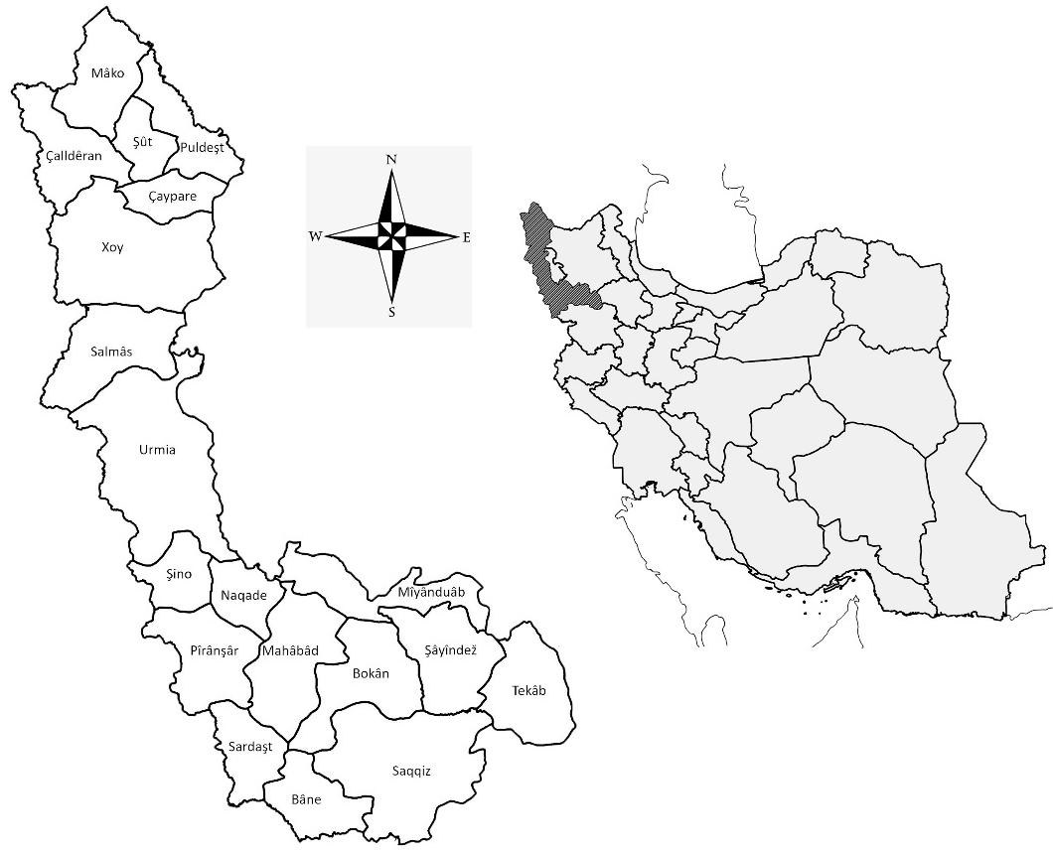
Kurdish
  Northeastern
  Mukri
Neo-Aramaic
  Jewish
  Christian
Turkic Azeri
Armenian
Notes:
in Northwestern Iran include Northeastern Kurdish, Mukri Kurdish (Indo-Iranian), Neo-Aramaic (which is represented by two dialects of Jewish and Christian) (Semitic), Turkic Azeri, and Armenian (Indo-European). These have been in contact for a long time under super-stratum of Persian as the official language of Iran. Data in this study include [go to the next slide]

Slide 22
Kurdish
  Northeastern
  Mukri
Neo-Aramaic
  Jewish
  Christian
Turkic Azeri
Armenian
Data:
Monologue narrative free speech and conversational data
Notes:
corpora of published and personal field data. All monologue narrative free speech and conversational data.
In order to gather acceptability judgments by the speakers on uncommon structures, I also set up [go to the next slide]

Slide 23
Kurdish
  Northeastern
  Mukri
Neo-Aramaic
  Jewish
  Christian
Turkic Azeri
Armenian
Data:
Monologue narrative free speech and conversational data
Crowdsourced experimental data (acceptability judgment)
Notes:
experiments and collected data by means of crowdsourcing via telecommunication. The purpose was to evaluate speakers’ perceptions of the acceptability of particular linguistic constructions, as well as their grammatical judgments with respect to variation in Target ordering. In the next slide, I will show you a typical example of a Target construction so you can visualize the structure [go to the next slide]

Slide 24
A target example

Slide 25
Mukri Kurdish
Subject Object Verb Preposition Target
ew-ân kitêb-êk =yân dâ be piyâw-ek-ân
they-pl book-indf =pc.3pl give.pst to man -def-pl
‘They gave a book to the men.’
Notes:
This is a typical example of an unmarked Target construction in Mukri. The Target which is the focus of this study is flagged with a [go to the next slide]

Slide 26
Mukri Kurdish
Verb-Target (VT)
Subject Object Verb Preposition Target
ew-ân kitêb-êk =yân dâ be piyâw-ek-ân
they-pl book-indf =pc.3pl give.pst to man -def-pl
‘They gave a book to the men.’
Notes:
a preposition in the postverbal position. Moreover, Targets can be also flagged in [go to the next slide]

Slide 27
Mukri Kurdish
Target-Verb (TV)
Subject Preposition Target Object Verb
ew-ân be piyâw-ek-ân kitêb-êk=yân dâ
they-pl to man -def-pl book-indf=pc.3pl give.pst
‘They gave a book to the men.’
Notes:
preverbal position. This was an introduction to the parameter of flagging and Target position, and now we will see the different distributions of Targets in the sample languages and their flagging [go to the next slide]

Slide 28
flagging and targets
Analysis of Word order variation
Notes:
Recall that in the typological literature of word order such as Greenberg (1963), Dryer (1992), and Hawkins (1994) among many others, flagging is introduced as an important factor in word order variation. In the next slide, we will see the distribution of flagging in the sample languages [go to the next slide]

Slide 29
 |  | Flagging
 | % | adposition | adposition+ case | case | bare
TV | Mukri | 23 | 27 | 2 | 0
 | NENA | 55 | 0 | 0 | 4
 | Armenian | 4 | 16 | 16 | 0
 | Azeri | 0 | 1 | 34 | 0
 | NEK | 3 | 26 | 0 | 0
VT | Mukri | 14 | 30 | 2 | 2
 | NENA | 25 | 0 | 0 | 16
 | Armenian | 4 | 7 | 27 | 26
 | Azeri | 3 | 11 | 46 | 5
 | NEK | 10 | 35 | 18 | 8
Notes:
All languages present flagging by an adposition (for example, depending on the language a preposition, a postposition, or a circumposition), by a case, by both an adposition and a case, or no flagging at all (which I called BARE). [go to the next slide]

Slide 30
 |  | Flagging
 | % | adposition | adposition+ case | case | bare
TV | Mukri | 23 | 27 | 2 | 0
 | NENA | 55 | 0 | 0 | 4
 | Armenian | 4 | 16 | 16 | 0
 | Azeri | 0 | 1 | 34 | 0
 | NEK | 3 | 26 | 0 | 0
VT | Mukri | 14 | 30 | 2 | 2
 | NENA | 25 | 0 | 0 | 16
 | Armenian | 4 | 7 | 27 | 26
 | Azeri | 3 | 11 | 46 | 5
 | NEK | 10 | 35 | 18 | 8
Notes:
First, as you can see, if there are BARE Targets, they are mostly or always postverbal. Even if I merge bare with case and only focus on the existence of adpositions as Haig (2015 and 2022) did, I still get the same results. But in terms of adpositional flagging [go to the next slide]

Slide 31
 |  | Flagging
 | % | adposition | adposition+ case | case | bare
TV | Mukri | 23 | 27 | 2 | 0
 | NENA | 55 | 0 | 0 | 4
 | Armenian | 4 | 16 | 16 | 0
 | Azeri | 0 | 1 | 34 | 0
 | NEK | 3 | 26 | 0 | 0
VT | Mukri | 14 | 30 | 2 | 2
 | NENA | 25 | 0 | 0 | 16
 | Armenian | 4 | 7 | 27 | 26
 | Azeri | 3 | 11 | 46 | 5
 | NEK | 10 | 35 | 18 | 8
Notes:
Haig (2022) says Kurdish word order esp. case of Goals, and Targets in my terminology, is morphosyntactically triggered. In case of interest, I can explain his generalization in the discussion. Overall, Haig doesn’t discuss the case of bound pronouns and his main findings are based on free pronouns, nominal, and adverbial Goals. But excluding bound pronouns gives a distorted, misleading, and overly narrow picture. In the next, I will present the detailed distribution of flagging only for nominal elements to have a better picture of the flagging types [go to the next slide]

Slide 32
Notes:
In this slide the only thing I want to focus on is that all types of adpositions and case exhibit in both positions. Thus

Slide 33
Left-branching (OV)
Right-branching (VO)
postpositional + Genitive-Noun
prepositional + Noun-Genitive
Notes:
According to the typological classifications this is an unusual type. Following Haig who speaks in favor of contact-induced change, the question is what is the development path of flagging types in the sample languages and another question would be if there is a development towards a bare form or vice versa? With respect to contact-induced change statement, let’s assume hypothetical situation for visualization purposes then I will exemplify the different development path.

Slide 34
Contact-Induced change internal development
Contact-induced non-changed

Slide 35
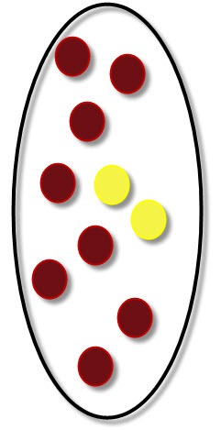
Notes:
In a hypothetical situation like this figure, there are two features of red and yellow. According to the typological hypothesize red feature is more frequent and the appearance of the two tokens of yellow seems [go to the next slide]

Slide 36
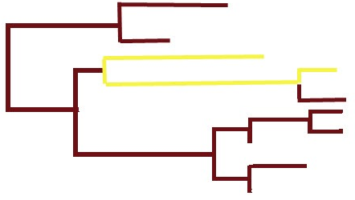
Notes:
to be a development due to contact, however, another question can be what if actually the red [go to the next slide]

Slide 37
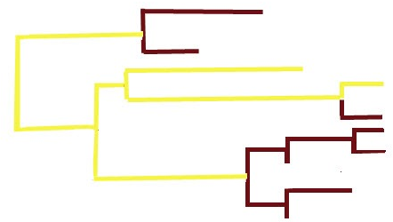
Notes:
is developed? As we see in this diagram, the number of possibilities are very large and answering this question requires an in-depth historical analysis.
Historically, Iranian languages had several cases which developed phonetically in various ways. This resulted in a reduced case system where several forms merged or some forms were generalised.

Slide 38
Cross-linguistically, various studies mainly focus on marking options and their explanations
non-marked elements?
Direct/oblique case marking
Case marking
Adpositional marking
Notes:
Two possibilities can be considered in this respect: one side, case marking was reduced to direct/oblique case and adpositional marking on the other. In principle,

Slide 39
Cross-linguistically, various studies mainly focus on marking options and their explanations
non-marked elements?
Direct/oblique case marking
Case marking
Adpositional marking
Notes:
simple oblique marking could suffice to flag a Target, especially if its status as a Target is clear. Iranian languages that only show direct/oblique marking tend to use the direct case as the default case and use the oblique one "in case of need". Thus, direct case would always be possible. No matter where a case form comes from, we usually end up with a direct and an oblique case and the oblique case can be derived from the direct case by adding a morpheme. [go to the next slide]

Slide 40
Languages that did develop case endings to form an oblique case appear to have generalised an inflectional pattern that appeared regularly to forms where this pattern cannot be historically reconstructed. Such analogical phenomena are quite common. One form is identified as the unmarked form and it is this one that receives the generalised case ending.
Now, we also see that some languages with case endings do not always mark oblique case although they have the means to do so and although grammar requests an oblique case. There are two ways of looking at that First it is possible to say that this is differential marking, so other factors (e.g. semantic factors) trigger the indication of case marking. In this sense, the noun is always in oblique case (as grammar requests it), but the formal representation differs. So in a language, two forms can be possible one as a marked oblique case and the other one as a differently marked oblique (by zero) that happened to be identical to the direct case.
Notes:
[go to the next slide]

Slide 41
Second, it can be mentioned that case marking is optional depending on other factors. Then there is an unmarked form, which is not indicated for case (neither direct, nor oblique), and a marked form. The unmarked form could be called “direct case” in contrast to the “oblique case”, but actually it wouldn’t exist, because it is the neutral form. If it is a subject, the language always uses the neutral form, whence it’s apparent “directness”. With adpositions, which sufficiently indicate obliqueness, use of oblique case is superfluous. The speaker has a choice. Using the marked form may have a special effect. In “street German” for instance, locatives often appear without case marking even though there is no adposition to indicate it as an example
Notes:
++++++++
In this regard, an assumption can be that languages which preserve the Old Iranic case system do not use the nominative as the default form that could substitute other case forms.
Moreover, accusative case and nominative may have coalesced in direct case, while the dative case may rather have merged in the oblique case. So, it's possible that minimal flagging is actually the original situation and that adpositional flagging was added when felt necessary.

Slide 42
ich bin Frankfurt meaning “I am in Frankfurt”.
Notes:
ich bin Frankfurt meaning “I am in Frankfurt”.
I personally assume that both explanations in terms of adpositional or case marking development can be correct for a language on its the grammaticalization path. If this is correct, the path would look as follows: [go to the next slide]
+++++++
In this regard, an assumption can be that languages which preserve the Old Iranic case system do not use the nominative as the default form that could substitute other case forms.
Moreover, accusative case and nominative may have coalesced in direct case, while the dative case may rather have merged in the oblique case. So, it's possible that minimal flagging is actually the original situation and that adpositional flagging was added when felt necessary.

Slide 43
(1) Proto-Iranian
dative case / accusative case for Targets
Notes:
Here I only focus on case of Iranian for the sake of time (1) Proto-Iranian: dative case / accusative case for Targets, two [go to the next slide]

Slide 44
(1) Proto-Iranian
dative case / accusative case for Targets
(2) Old Iranian
dative case / accusative case for Targets dative case / accusative case for Targets supported by adverbials (that may qualify as adpositions)
Notes:
Old Iranian: dative case / accusative case for Targets dative case / accusative case for Targets supported by adverbials (that may qualify as adpositions). On the other hand, the question is whether in Middle Iranian, the direct case is used for Targets? I would think that one would use the oblique case in the languages where it is available. The third possibility [go to the next slide]

Slide 45
(1) Proto-Iranian
dative case / accusative case for Targets
(2) Old Iranian
dative case / accusative case for Targets dative case / accusative case for Targets supported by adverbials (that may qualify as adpositions)
(3) Middle Iranian
direct case for Targets
oblique case for Targets
direct/oblique case for Targets supported by adverbials (that may qualify as adpositions)
Notes:
Middle Iranian: direct case for Targets and oblique case for Targets. direct/oblique case for Targets supported by adverbials (that may qualify as adpositions) and fourth [go to the next slide]

Slide 46
(1) Proto-Iranian
dative case / accusative case for Targets
(2) Old Iranian
dative case / accusative case for Targets dative case / accusative case for Targets supported by adverbials (that may qualify as adpositions)
(3) Middle Iranian
direct case for Targets
oblique case for Targets
direct/oblique case for Targets supported by adverbials (that may qualify as adpositions)
(4) New Iranian
direct case for Targets
oblique case for Targets
direct/oblique case for Targets plus adpositions
Notes:
New Iranian direct case for Targets and oblique case for Targets. direct/oblique case for Targets plus adpositions. Concerning this scenario, it is also possible to assume that adpositions might date back to Proto-Iranian or maybe even Proto-Indo-Iranian, in a "proto-adposition" form. It might be that in Old Iranian, for which reason one might reconstruct it for the proto-language -- although of course this is not compelling as both branches could have shown a parallel development. So in case of bare cases, i.e., without any flagging, I hypothesize the following stages for sample languages [go to the next slide]

Slide 47
 | Flagging | stage I | stage II | stage III
1 | adposition +/- case
2 | reduced adposition +/- case
3 | -adposition +case
4 | -adposition -case
Notes:
At the first stage, i.e., the initial stage of change, NENA

Slide 48
 | Flagging | stage I | stage II | stage III
1 | adposition +/- case | NENA
2 | reduced adposition +/- case
3 | -adposition +case
4 | -adposition -case
Notes:
still presents a systematic use of adpositions for flagging Targets, Mukri and Azeri

Slide 49
 | Flagging | stage I | stage II | stage III
1 | adposition +/- case | NENA
2 | reduced adposition +/- case |  | Mukri
3 | -adposition +case |  | Turkic Azeri
4 | -adposition -case
Notes:
are in the second stage by presenting variation in terms of flagging Targets. In case of Mukri oblique case marking is not systematically used. These two languages are considered to be in the process of change and transition. Armenian and Northeastern Kurdish are

Slide 50
 | Flagging | stage I | stage II | stage III
1 | adposition +/- case | NENA
2 | reduced adposition +/- case |  | Mukri
3 | -adposition +case |  | Turkic Azeri
4 | -adposition -case |  |  | Armenian NEK
Notes:
at the last stage of development and have bare Targets. Northeastern Kurdish is already established as a postverbal language with a high number of bare Targets in comparison to other languages. Northeastern Kurdish can be considered as a new flagging-drop language type.
Among various PoS, adverbial Targets, for example home, there, and here, are frequently bare, i.e., without adpositions, and in case of Azeri and Armenian, without case as well. Similar to this PoS type, other PoS types such as nouns, proper names, city names, and common names can show a similar tendency. In Azeri, at the current stage, mostly adverbial Targets such as there and here are attested to be commonly bare. The corpus study demonstrates that bare form is a productive phenomenon, which is also attested cross-linguistically for goals (e.g., [go to the next slide]

Slide 51
Concluding remark

Slide 52
BARE = no adpositional or case marking
Contact-induced change ?!
Internal development
  Discourse-pragmatic factors such as information structure, focality etc.
  Cognitive explanations such as iconicity
Notes:
According to current investigation, contact-induced change for both the placement and flagging of Targets is not explanatory,
The historical data shows the existence of all possible flagging forms as well so their frequency can be due to internal motivation
A higher rate of postverbal bare Targets can be due to discourse-pragmatic factors such as information structure as well as iconicity principle

Slide 53
Prepositional, Postpositional etc.
Contact-induced change ?!
Internal development
  Discourse-pragmatic factors such as information structure, focality etc.
  Cognitive explanations such as iconicity
Notes:
Count examples are Korn studies on Balochi and Juegel on Middle Iranian and several other languages outside of the area of contact

Slide 54
Direction of flagging vs. bare development
Awaits further in-depth historical investigation
Notes:
Count examples are Korn studies on Balochi and Juegel on Middle Iranian and several other languages outside of the area of contact

